Slide 1
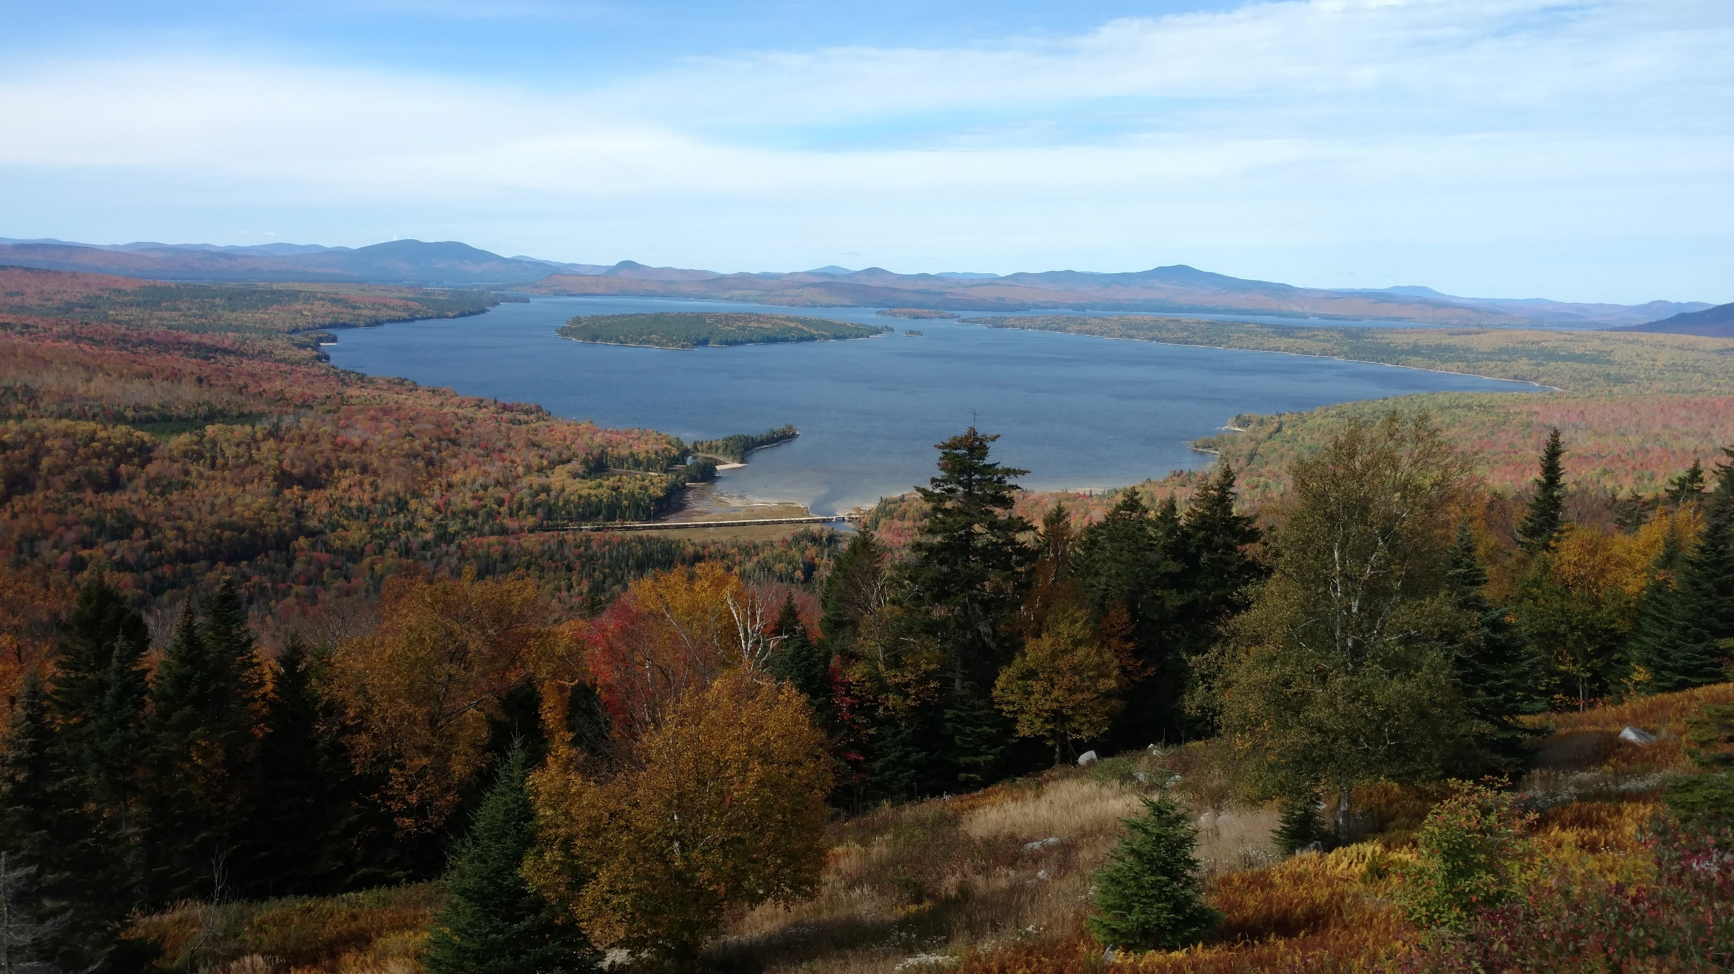

Species Updates
Amanda Cross
U.S. Fish and Wildlife Service
Field Supervisor
Maine Ecological Services Offices
East Orland and Falmouth, Maine
USACE Meeting September 23, 2024
Photo: Patrick Dockens

Slide 2
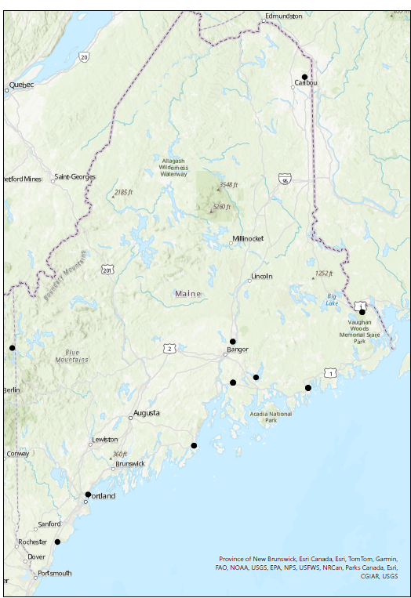
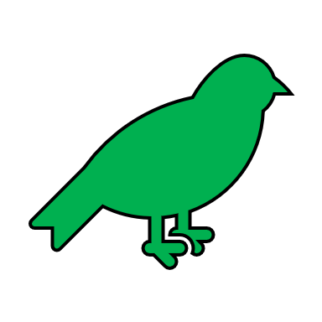





U.S. Fish and Wildlife Offices and Refuges in Maine
Refuges
Hatcheries
Fish and Wildlife Conservation
Law Enforcement
Ecological Services

Slide 3
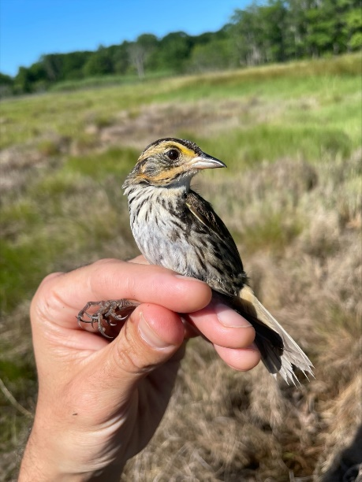
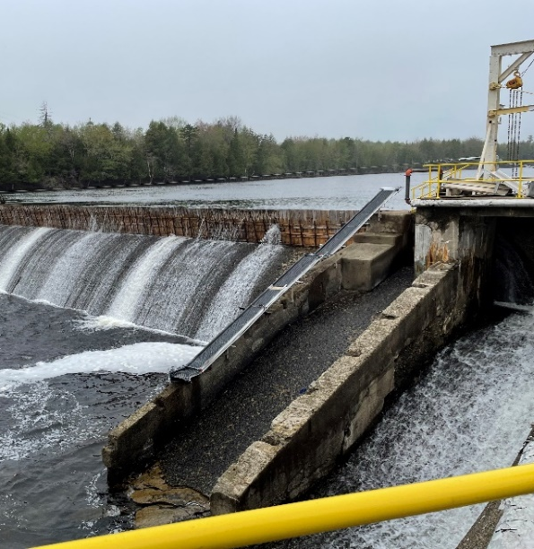
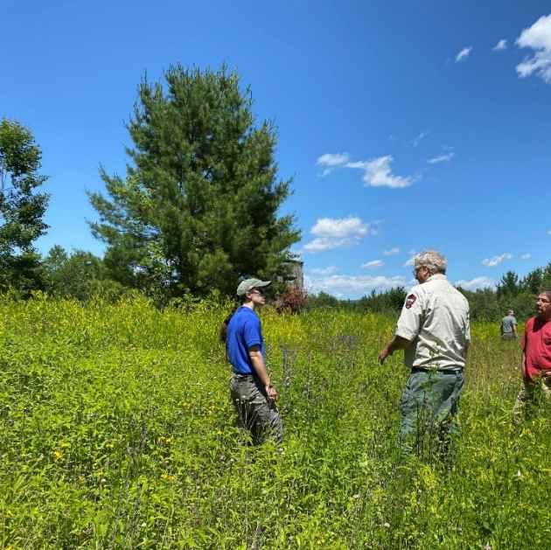
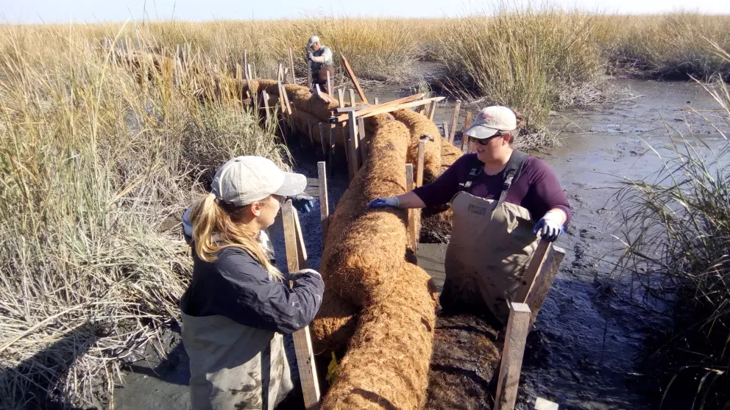
Maine Ecological Services Offices
Maine Field Office – East Orland
Gulf of Maine Coastal Program - Falmouth
Endangered Species
Hydropower
Partners for Fish and Wildlife Program
Coastal Ecosystems Conservation

Slide 4
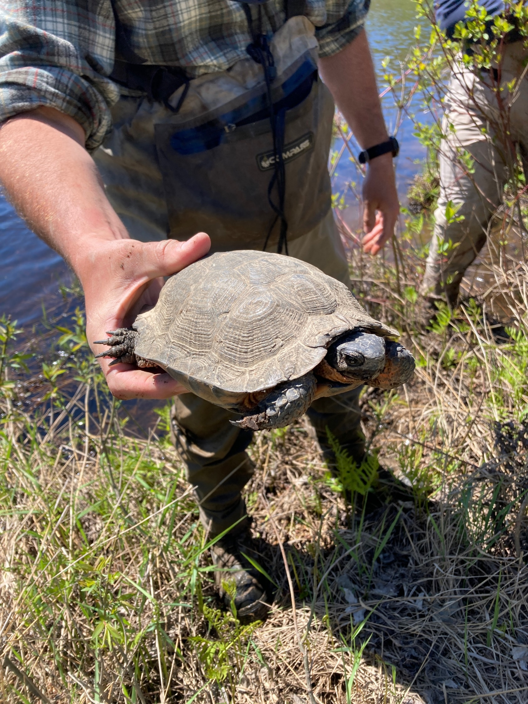
ESA Compliance and Conservation
Threatened and Endangered Species (10)
Fish (1)
Mammals (2)
Birds (3)
Plants (3)
Invertebrates (1)
Priority at-risk Species (>20)
Candidate species
Species under review
Other declining species

Slide 5
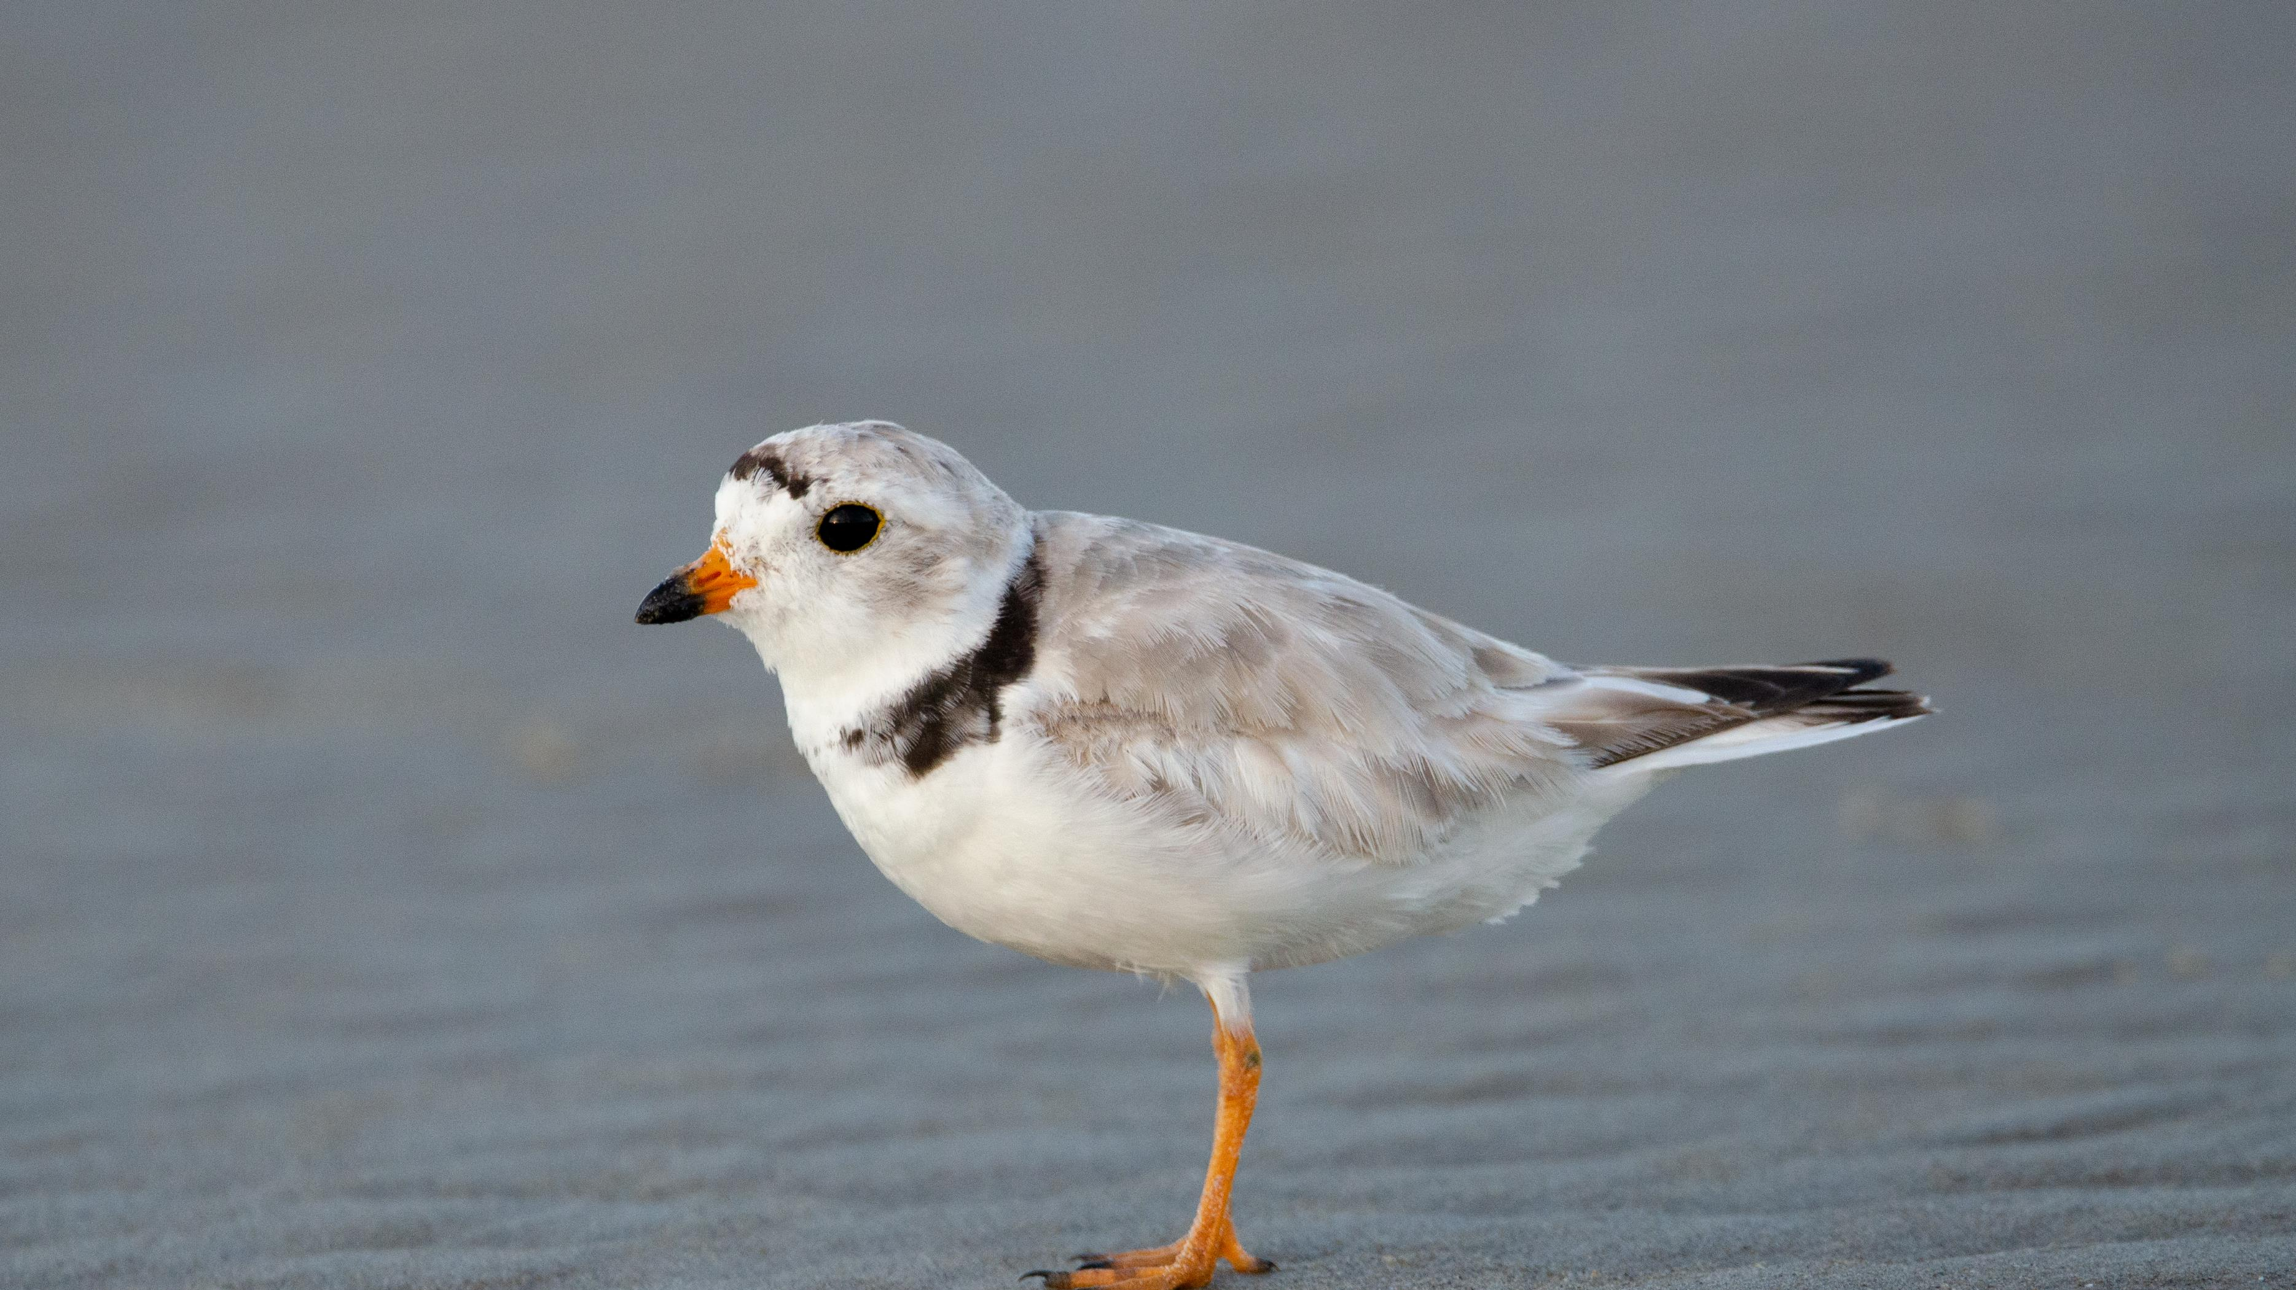
Listed Species

Slide 6

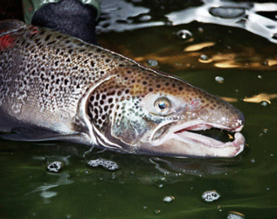


Atlantic Salmon (Salmo salar)
2019 – Recovery plan finalized
November 22, 2020 – 5-year review finalized
Shared jurisdiction with NOAA, split at the tide line
Photo: Edward Peter Steenstra, USFWS
Notes:
Not much has changed
the Service and its conservation partners continue to make progress towards recovery
Programmatics in place for FHWA, MaineDOT, Corps, FEMA, NRCS

Slide 7
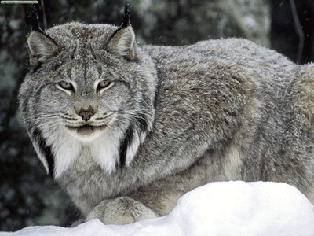
Canada Lynx (Lynx canadensis)
Currently listed as threatened with critical habitat
December 2023 – Species Status Assessment Addendum was completed
December 2023 – Draft recovery plan released
December 2024 – Final recovery plan to be released
September 2025 – Critical habitat rule revision scheduled to be published
Photo: USFWS

Slide 8
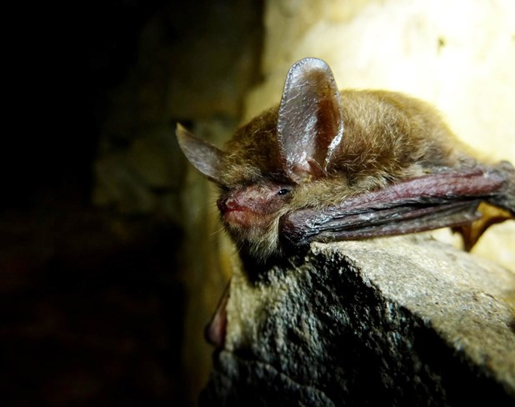
Northern Long-eared Bat (Myotis septentrionalis)
Currently listed as endangered without critical habitat
Spring 2023 - Interim Guidance released
Was supposed to expire April 1, 2024
Extended until new tools are released
2024 Survey Guidance
Includes guidance on structure surveys
Photo: NPS, Steven Thomas

Slide 9
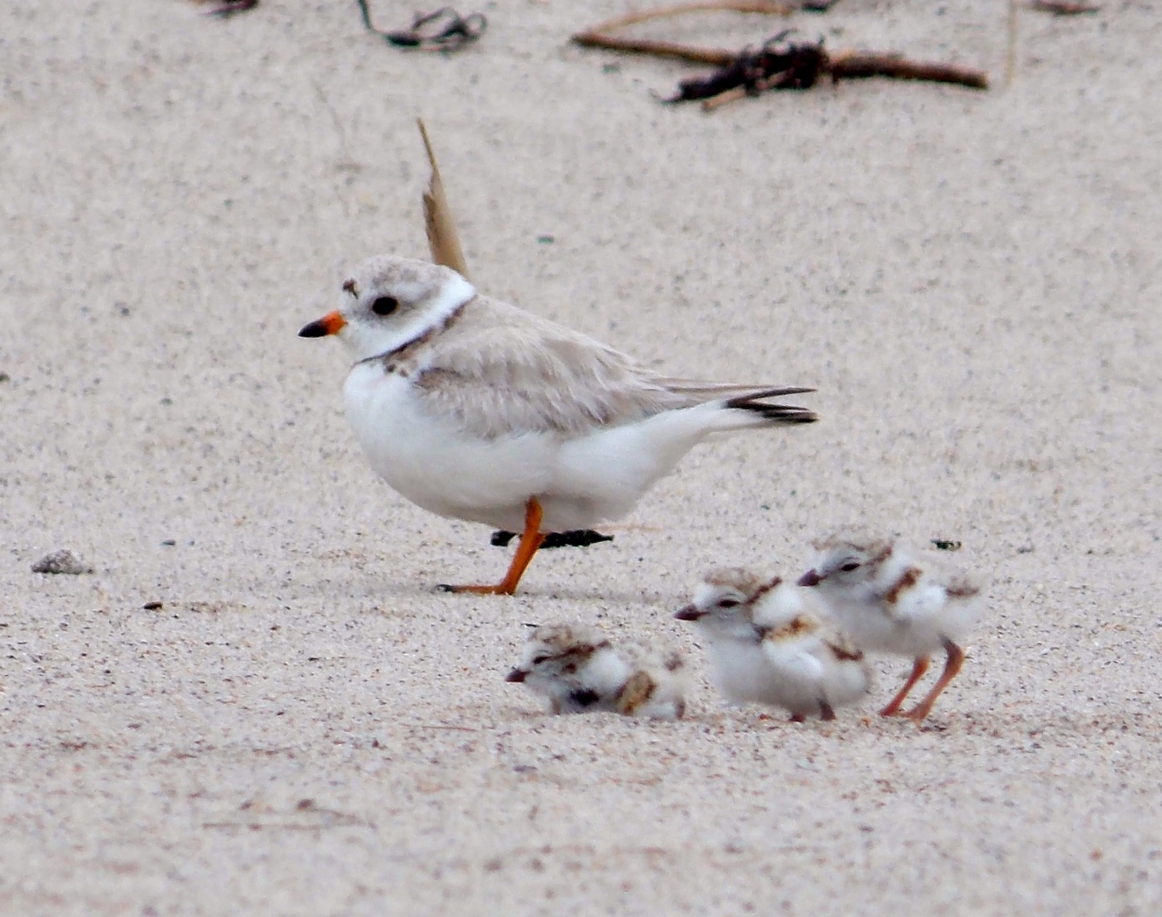
Piping Plover (Charadrius melodus)
Currently listed as threatened
2022 – 5-year review
March 16, 2016 – Draft recovery plan published
The last few years were the most productive recorded on Maine’s beaches
FY 24 – New 5-year review
Photo: USFWS
Photo: Kaiti Titherington/USFWS

Slide 10
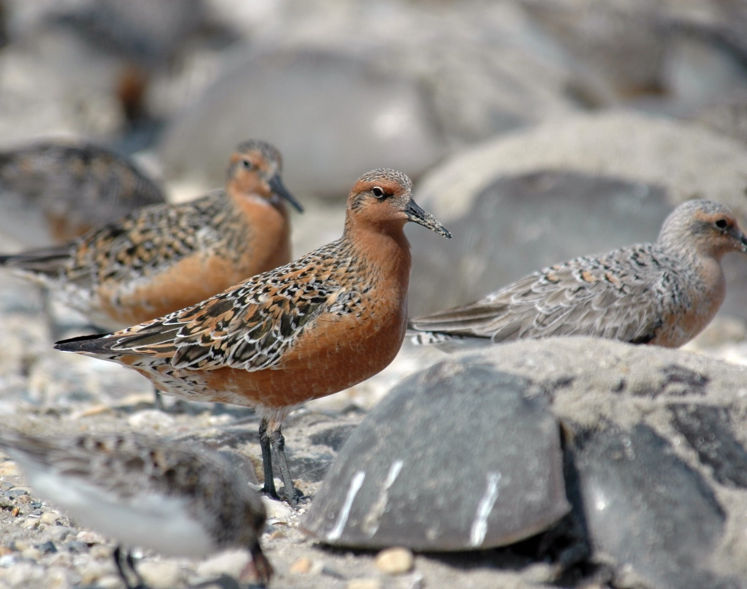
Red Knot (Calidris canutus rufa)
Currently listed as threatened
December 6, 2021 – 5-year review completed
July 15, 2021 – Proposed critical habitat
FY 2022 – Final recovery plan
FY 2024 – Final critical habitat
Photo: Gregory Breese, USFWS

Slide 11
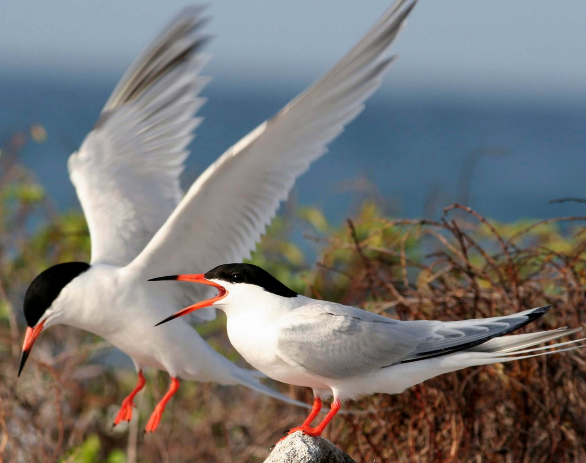
Roseate tern (Sterna dougalii dougalii)
Currently listed as endangered (NE DPS)
November 5, 1998 – Recovery plan
August 2020 – 5-year review of NE DPS
June 23, 2021 – 5-year status review initiated for entire population
Photo: USFWS
Photo: USFWS

Slide 12
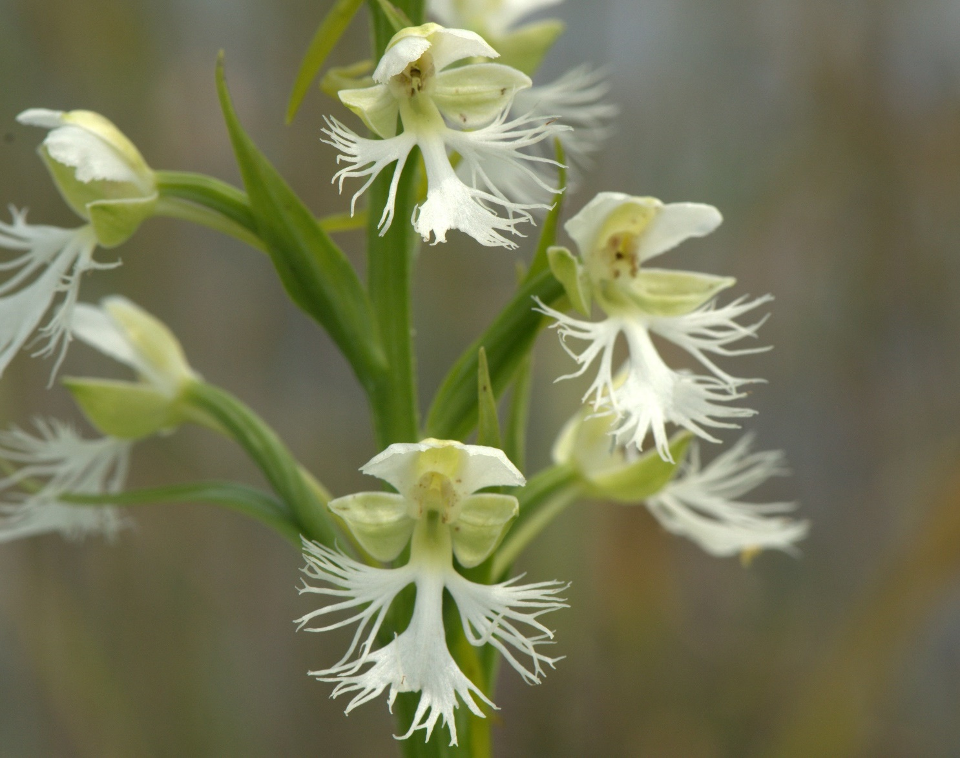
E. Prairie Fringed Orchid (Platanthera leucophaea)
Currently listed as threatened
In Maine, known from only one population at Crystal Bog
Eastern central Maine, near Island Falls
December 15, 2020 – 5-year review completed
Photo: USFWS
Photo: Joshua Mayer
Notes:
Important to also contact Maine Natural Areas Program if there are any question regarding potential habitat or presence

Slide 13
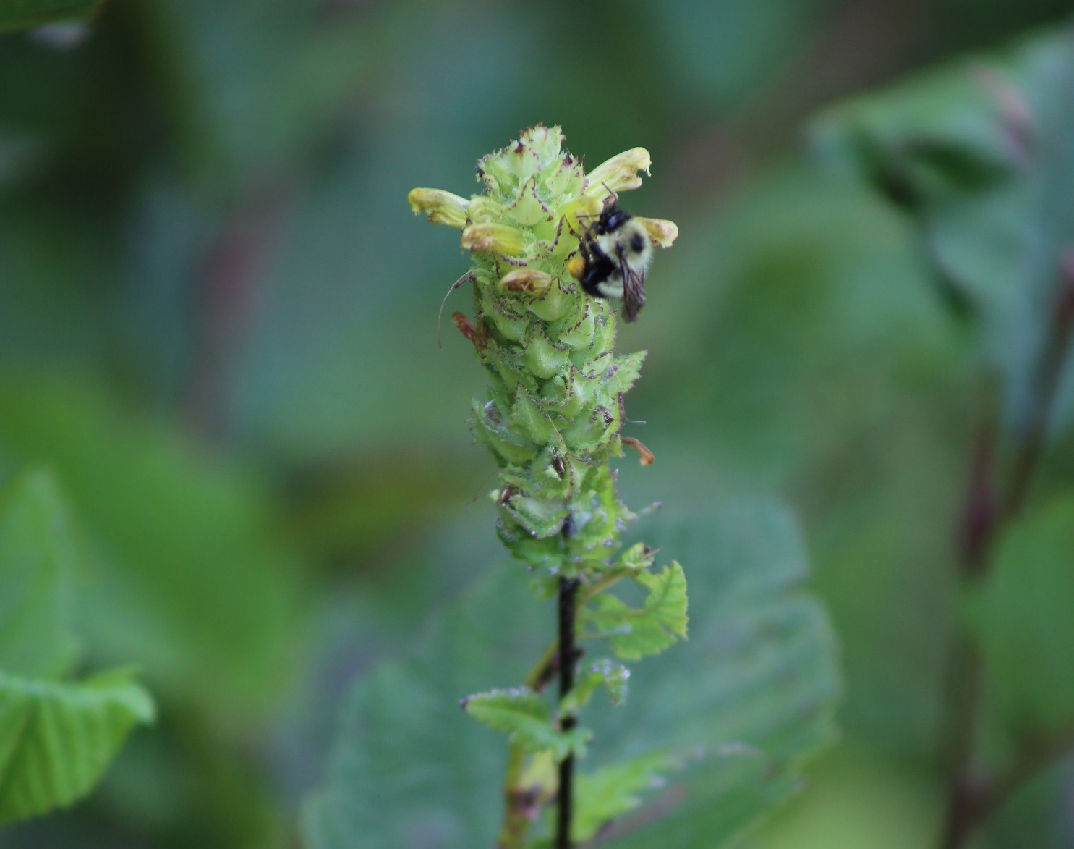
Furbish's Lousewort (Pedicularis furbishiae)
Currently listed as threatened
September 26, 2019 – Recovery plan published
January 15, 2021 – Proposed for downlisting to threatened
2023 – Final downlisting decision
Photo: USFWS
Photo: Meagan Racey, USFWS

Slide 14
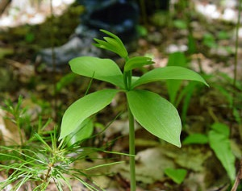
Small Whorled Pogonia (Isotria medeoloides)
Currently listed as threatened
Southern Maine
2022 – 5-year review
November 13, 1992 – Recovery plan published
Photo: USFWS
Photo: USFWS

Slide 15
Piping Plover (Charadrius melodus)
Currently listed as threatened
2022 – 5-year review
March 16, 2016 – Draft recovery plan published
The last few years were the most productive recorded on Maine’s beaches
FY 24 – New 5-year review
Photo: USFWS
Photo: Kaiti Titherington/USFWS

Slide 16
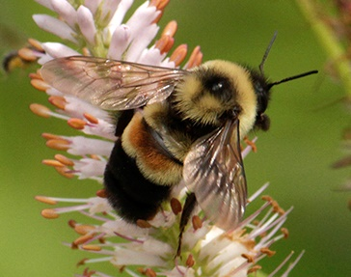
Rusty Patched Bumble Bee (Bombus affinis)
Currently listed as endangered
Last known occurrence in Maine was observed in 2009
August 26, 2021 – Final recovery plan published
2022 – 5-year status review started
Critical habitat (CH) slated to be listed FY25
Photo: USFWS
Photo: Susan Day; UW-Madison Arboretum

Slide 17
Non-listed and Proposed Species

Slide 18
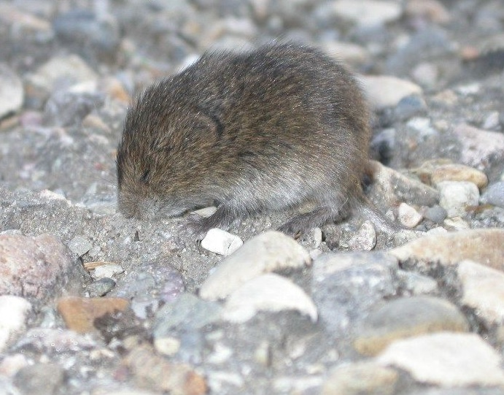
Northern Bog Lemming (Synaptomys borealis)
Not currently listed
2021 – Species status assessment
FY 2024 – 12-month finding on possible listing
Photo: Juan José Ramos

Slide 19
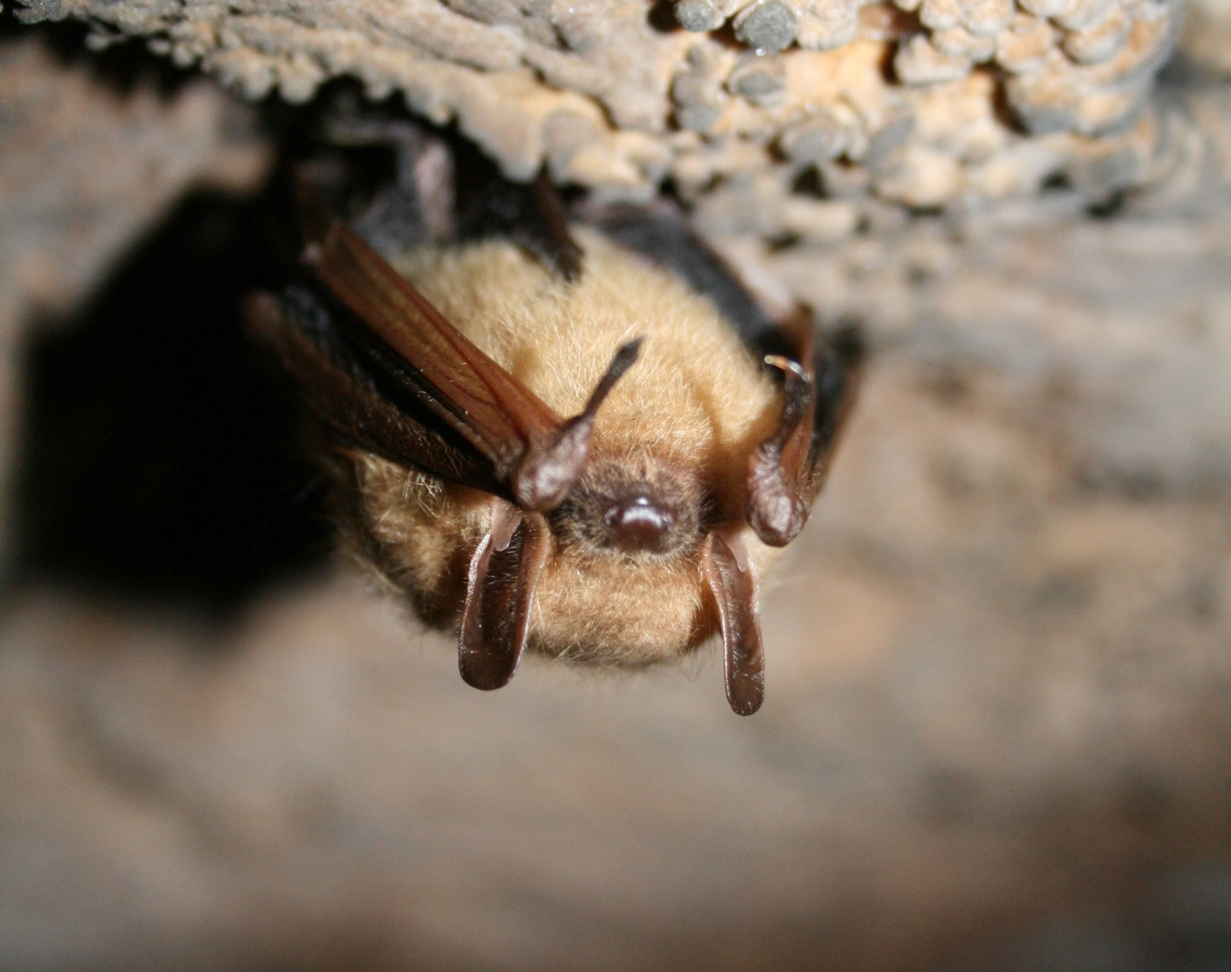
Tricolored Bat (Perimyotis subflavus)
Not currently listed
September 2022 - The Service proposed to list as endangered
In the event TCB is listed, tools will be released to aid in consultations
2025 Survey Guidance
Will have more specific guidance for tricolored bat, if listed
Photo: USFWS

Slide 20
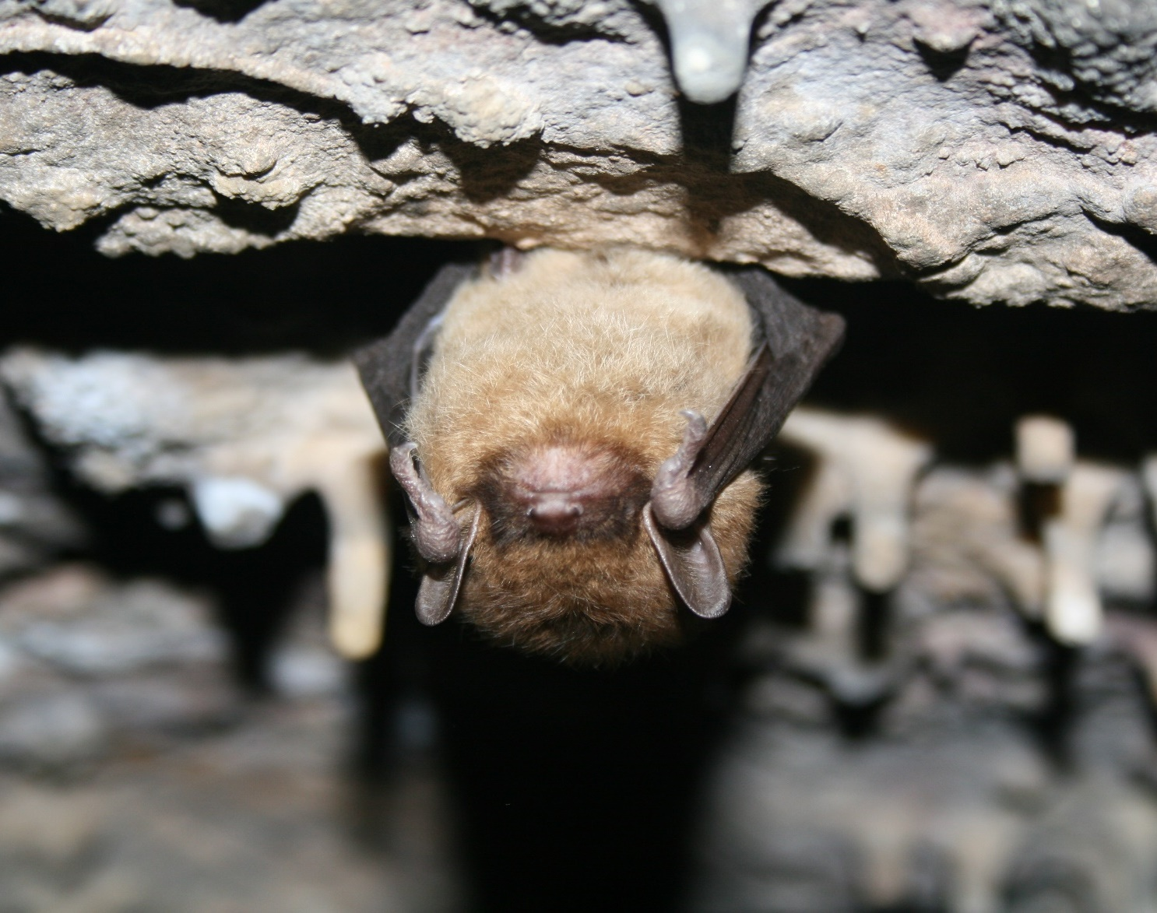
Little Brown Bat (Myotis lucifugus)
Not currently listed
FY 2024 – Status assessment and listing decision
Photo: USFWS
Notes:
(if warranted, most likely combined with proposed listing and critical habitat rules)

Slide 21
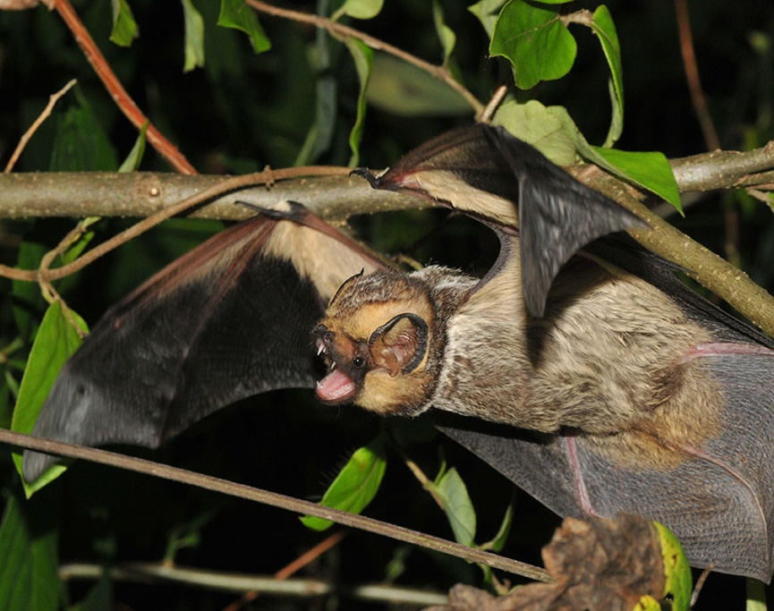
Hoary Bat (Lasiurus cinereus)
Not currently listed
FY 2027 – Listing decision
Photo: James Kiser
Notes:
(if warranted, most likely combined with proposed listing and critical habitat rules)

Slide 22
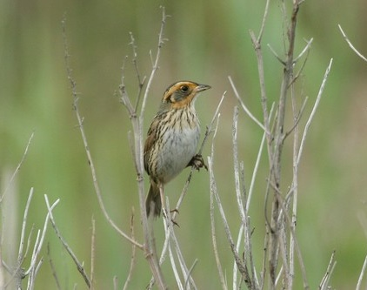
Saltmarsh Sharp-tailed Sparrow (Ammodramus caudacutus)
Not currently listed
FY 2022 – Species status assessment
FY 2024 – 12-month finding on possible listing
Photo: Dominic Sherony

Slide 23
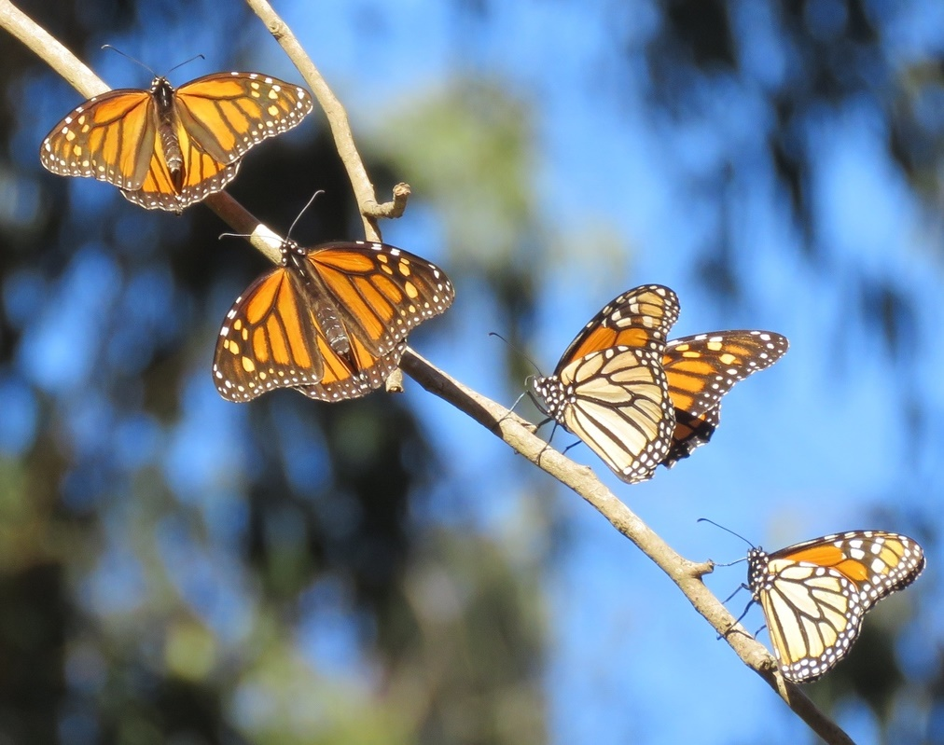
Monarch (Danaus plexippus)
September 9, 2020 – Species status assessment
December 17, 2020 – Listing decision – Listing is warranted but precluded
Candidate status
FY 25 – The Service will make a final listing decision for monarch
Photo: Liam O'Brien
Notes:
Candidate Conservation Agreements with Assurances
MaineDOT hasn’t, but plans to

Slide 24
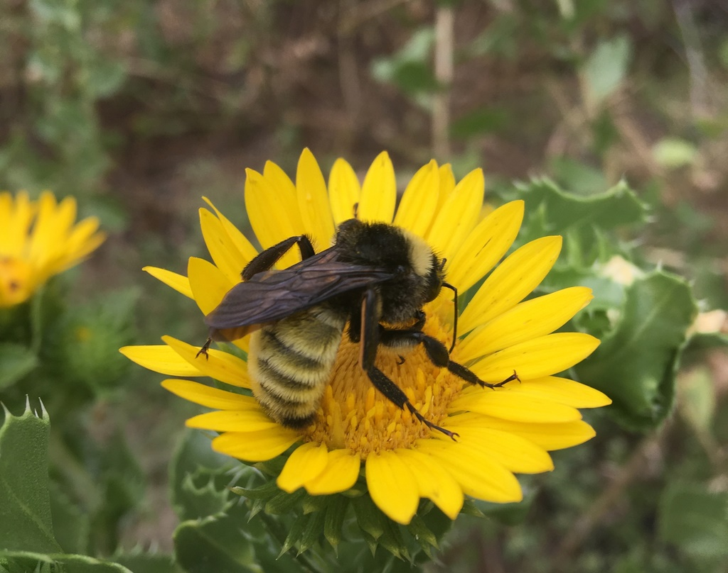
American Bumble Bee (Bombus pensylvanicus)
Not currently listed
September 29, 2021 – Species status assessment started
FY 2027 – 12-month finding on possible listing
Photo: Nicholas Martinez

Slide 25
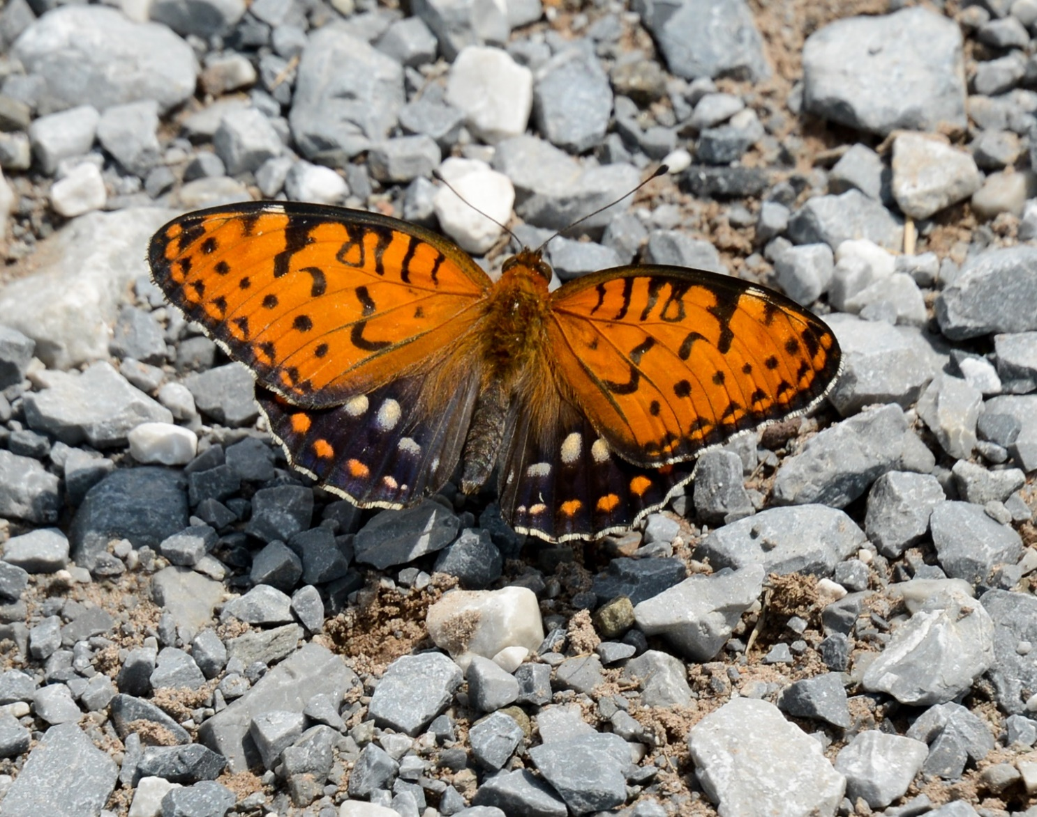
Regal Fritillary (Speyeria idalia)
Not currently listed
FY 2022 – Species status assessment
FY 2024 – 12-month finding on possible listing
Photo: Pennsylvania National Guard

Slide 26
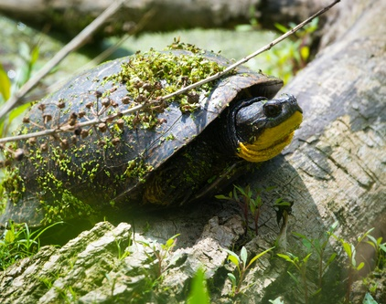
Blandings Turtle (Emydoidea blandingii)
Not currently listed
FY 2024 – 12-month finding on possible listing
Photo: Andrew Cannizzaro

Slide 27
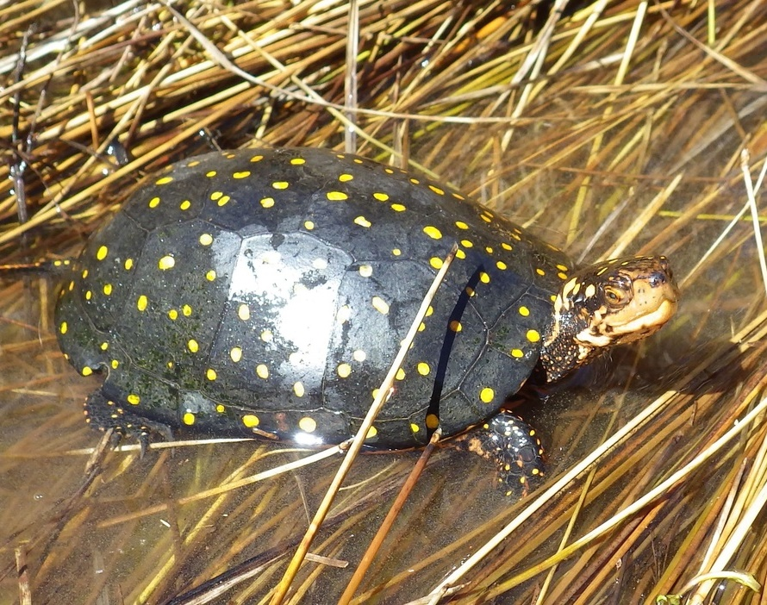
Spotted Turtle (Clemmys guttata)
Not currently listed
FY 2024 – 12-month finding on possible listing
Photo: Tom Preney

Slide 28
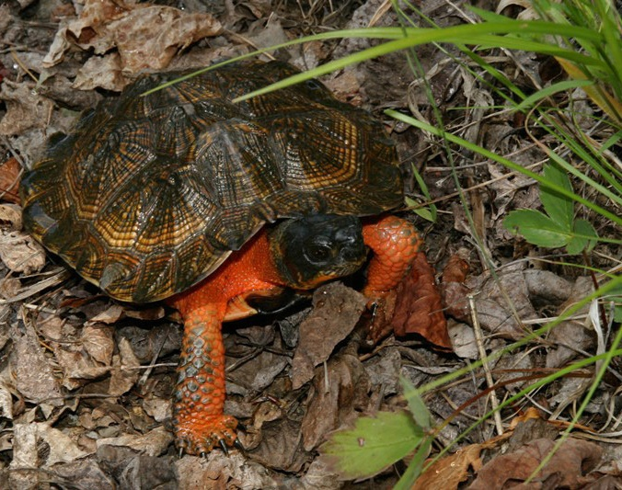
Wood Turtle (Glyptemys insculpta)
Not currently listed
FY 2024 – 12-month finding on possible listing
Photo: Diana-Terry Hibbitts

Slide 29
For More Information
Maine Ecological Services Field Offices:
Maine Field Office: https://www.fws.gov/office/maine-ecological-services
Email: mainefieldoffice@fws.gov
Gulf of Maine Coastal Program: https://www.fws.gov/office/gulf-maine-coastal-program
Other websites:
IPaC: https://ipac.ecosphere.fws.gov/
IPaC beta: https://ipacb.ecosphere.fws.gov/
Section 7 guidance: https://www.fws.gov/service/esa-section-7-consultation
Photo: Patrick Dockens

